Slide 1
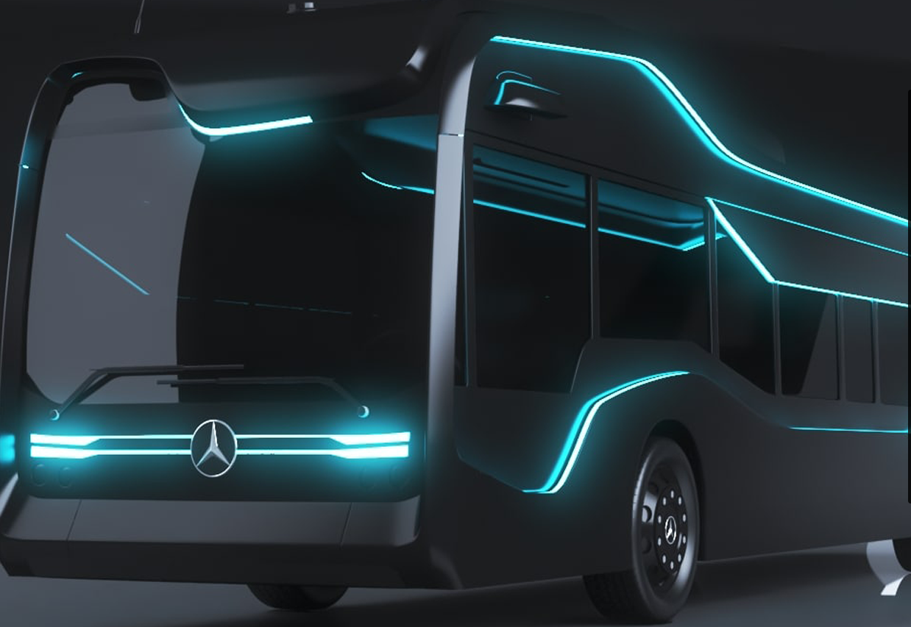
PLA Life Cycle –User Manual
November 2020
Version 1.0

Slide 2
Life Cycle(Part Tree) Overview
Introduction
System walkthrough

Slide 3

Introduction
The lifecycle is one of the main elements of the PLA application. It is the visual representation of a part's complete lifecycle. Each and every information belonging to a part is displayed in this easy-to-use tree view. On the left hand side there is a tree that represents data categories. On the right hand side there is a tab section. Lifecycle for any part can be open from all modules(Search, Recall, IDC, Single Recall).
Life Cylce can be opened from two ways-
Protected view from any module.
Public view using Direct link.

Slide 4
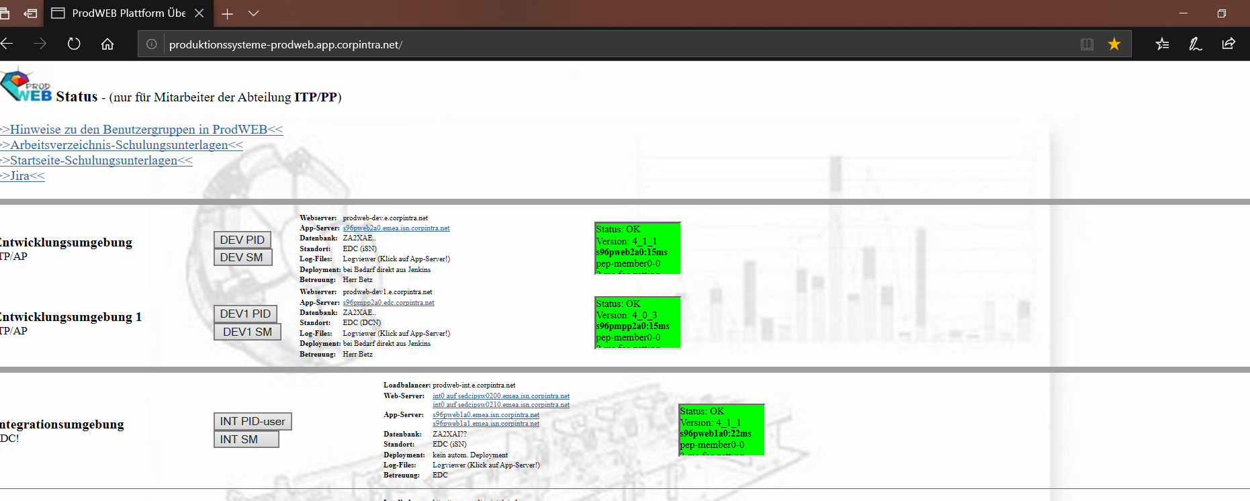
Initiation
Navigate to http://produktionssysteme-prodweb.app.corpintra.net/.
Click on Dev1 SM and Enter your credentials
Click on DEV1 SM

Slide 5
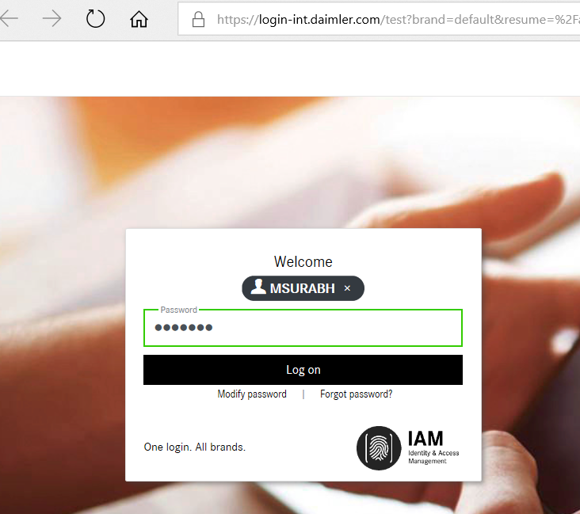
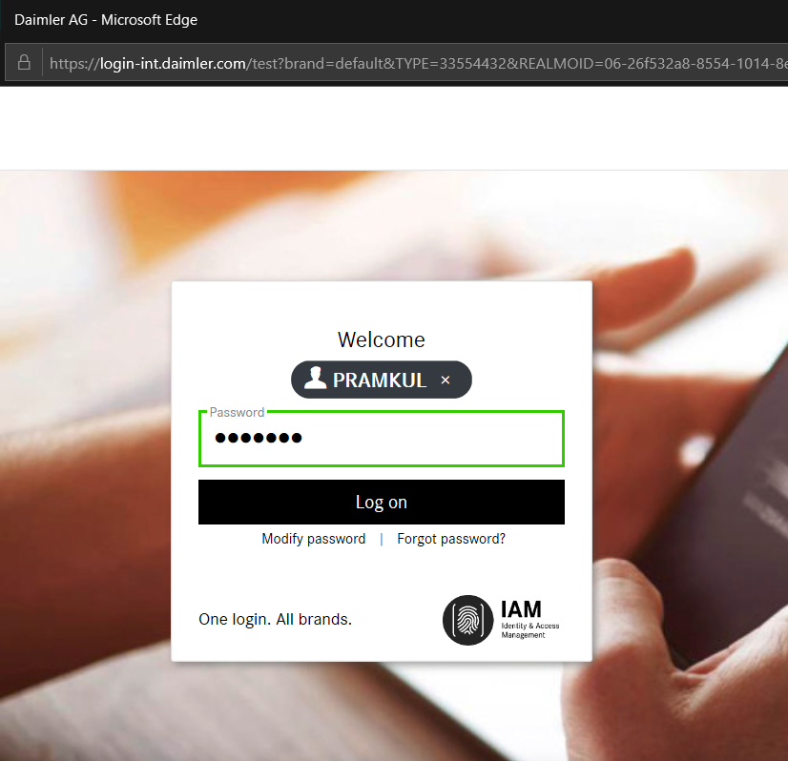
Initiation
Enter valid user name and password and Click on Log on button
Enter the Login credentials
Click on Log on

Slide 6
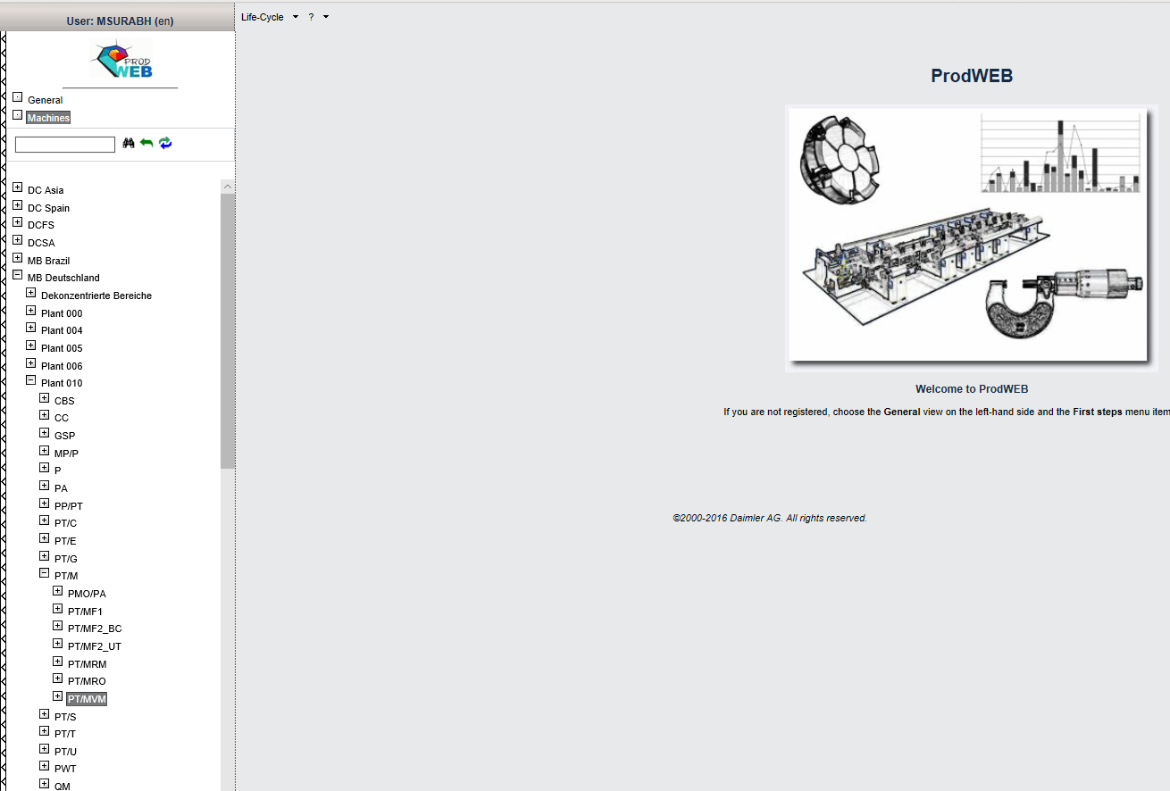
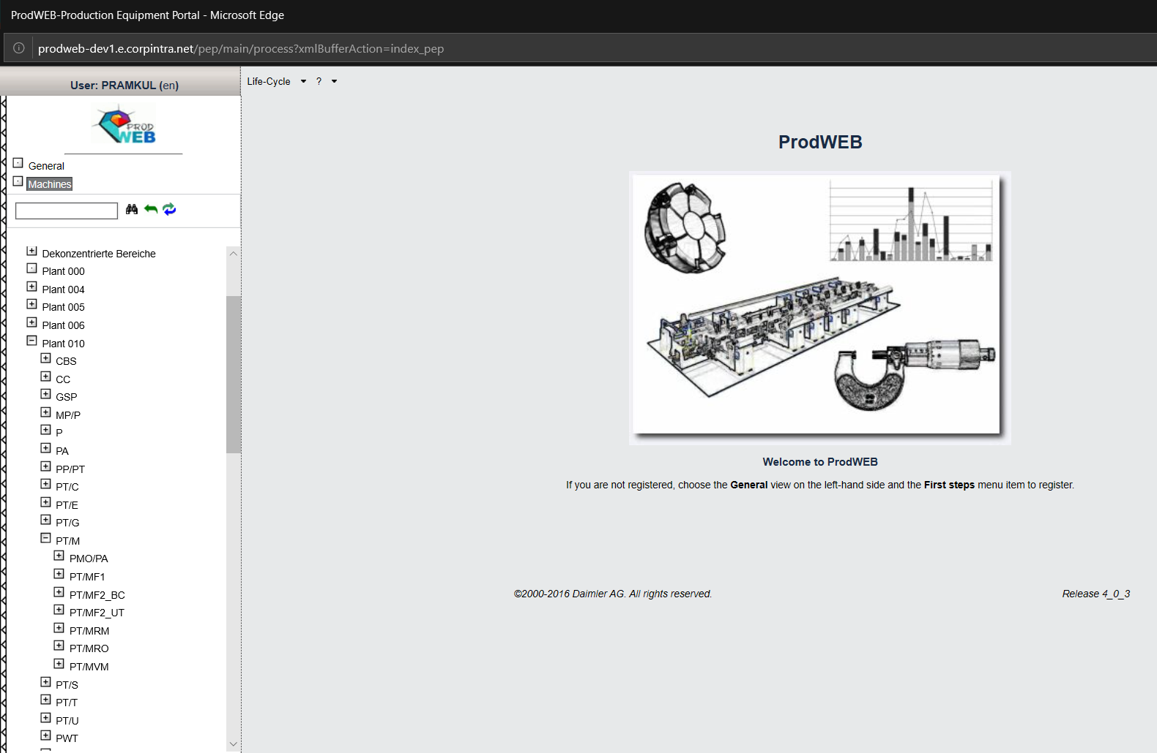
Home Page-Prod web tree
On Click of login button Prod web page is displayed.
PLA user can select respective Plants and Cost center and access the PLA application
Plant 10
To select particular node navigate from Machines->Plant 10 →Production Engines[PT/M] → PT/MVM
PT/M Consists of Production Engine information
All Engine Component Manufacturing information is present in node PT/MVM

Slide 7
Content
System Tutorial

Slide 8
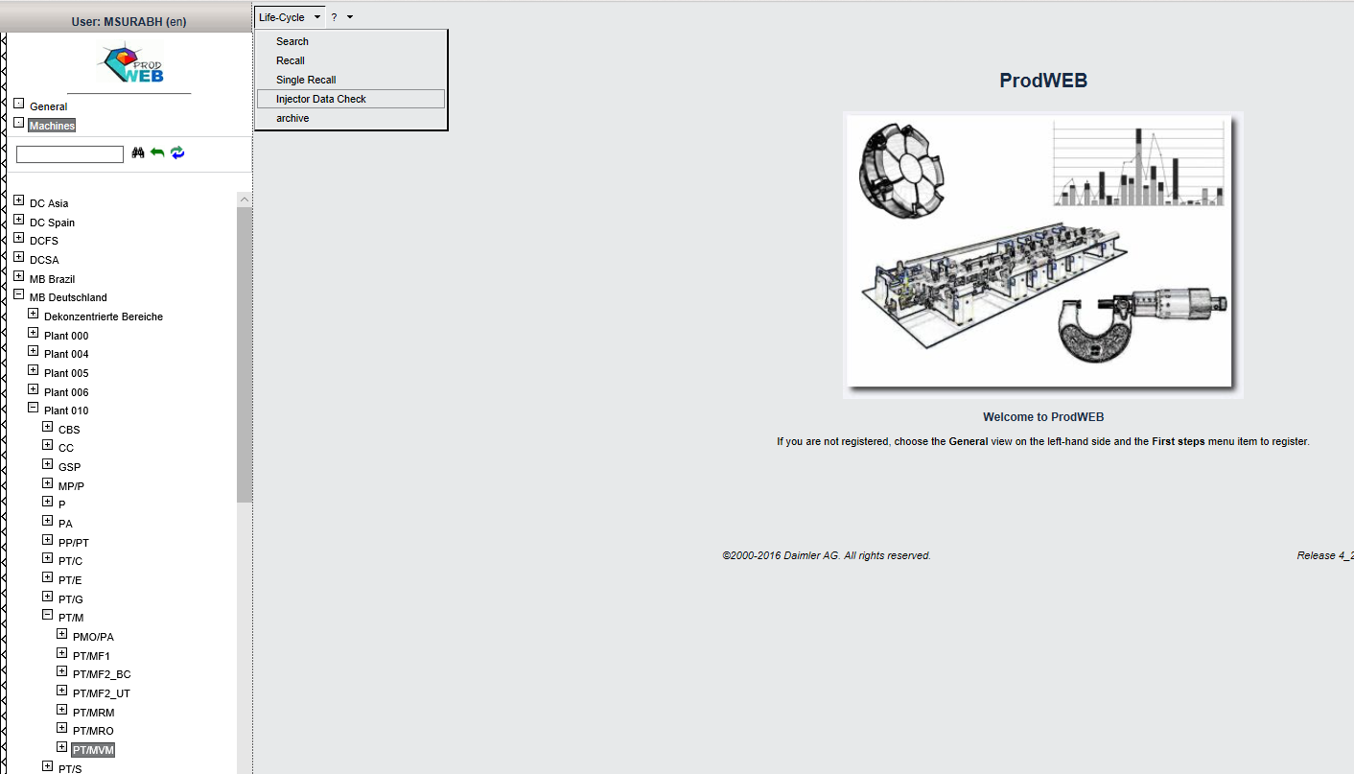
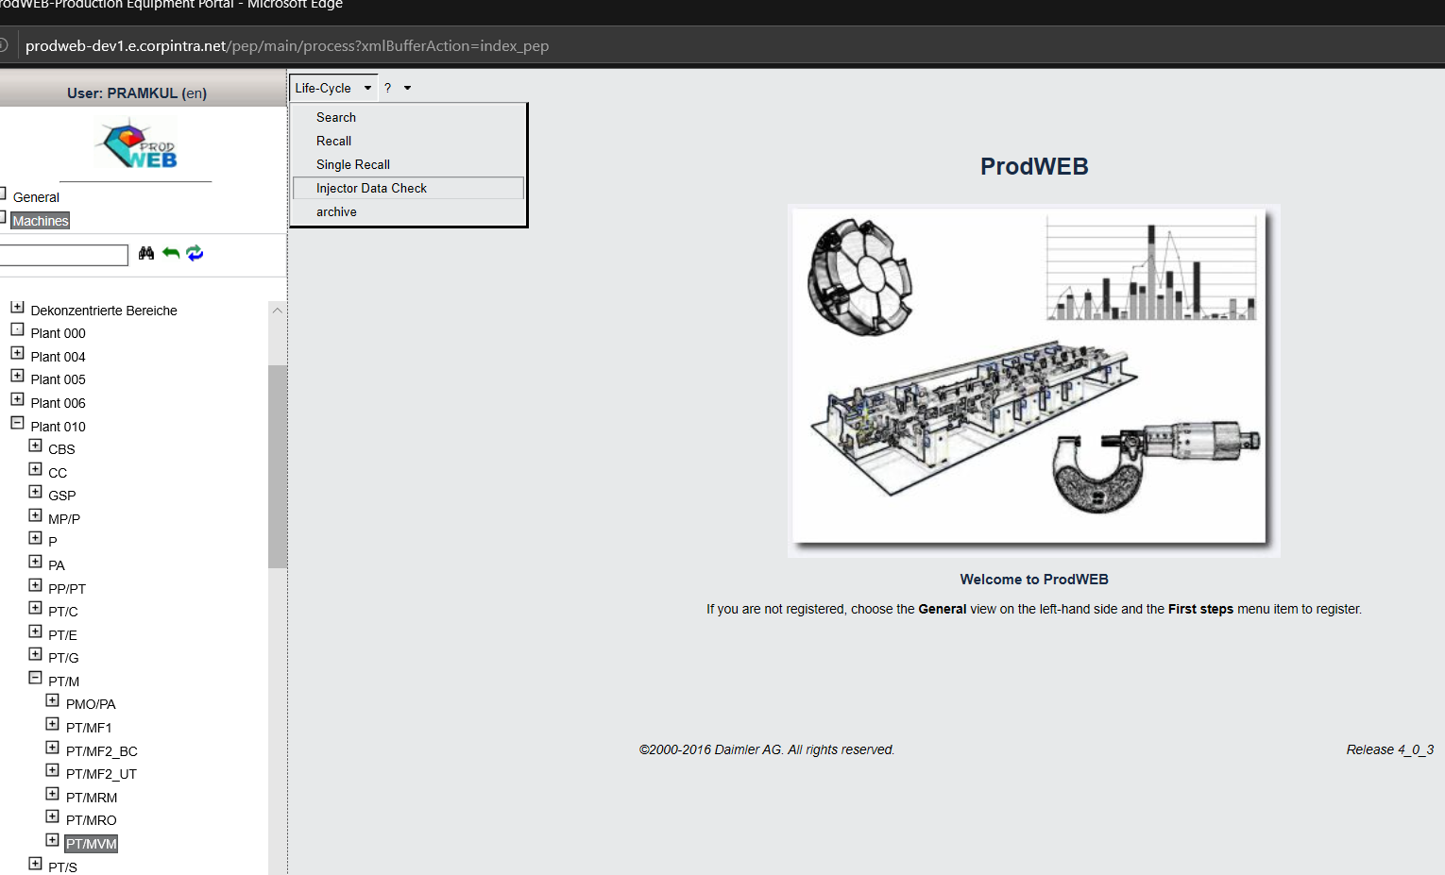
System Tutorial Navigation
PLA-User can access any module based on the rights assigned to each user. On Click of Search module Search view page will be displayed
Life Cycle Menu bar Consists of 5 modules. Search, Recall, Single Recall, Injector data check and archive. Select Search from the drop down list. Separate Search view window should ne opened.
MBRDI is only responsible for Search, Recall, Single recall and Injector Data check. Archive is not in the scope of MBRDI.

Slide 9
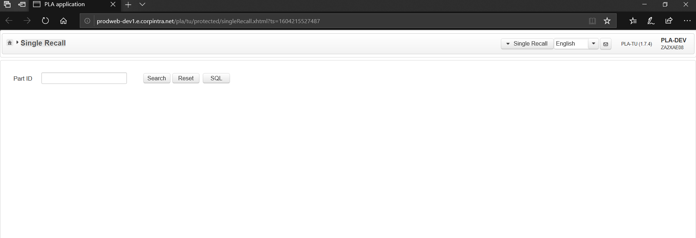
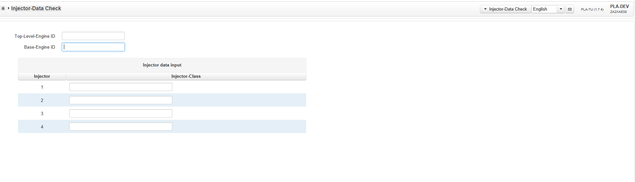
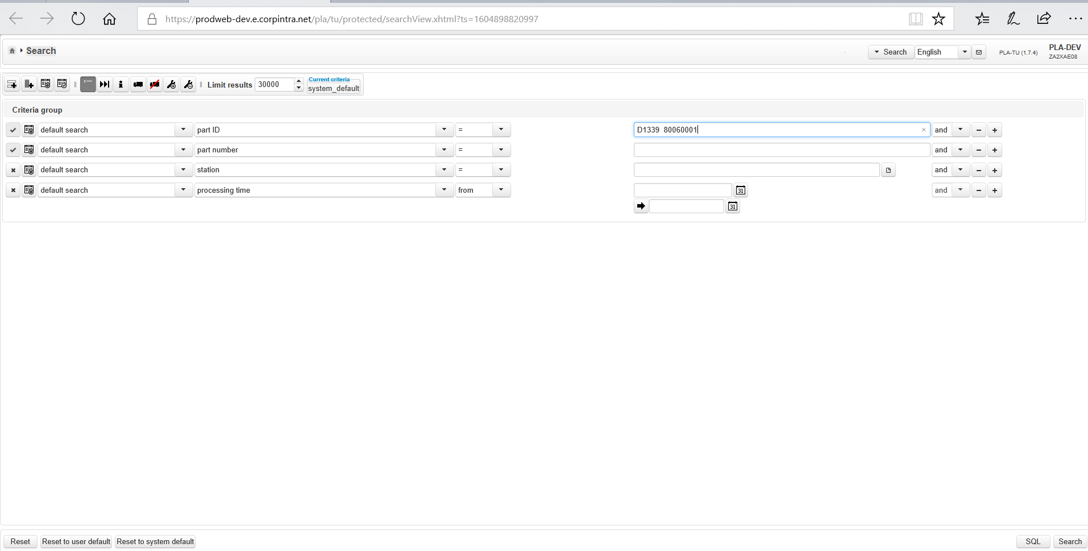
Search View Page
Module Switcher to navigate from Single recall to other modules.
Enter the part id as D13339 80060001 and click on search button.
PLA Recall user has option to change language from English to German and Vice Versa
Click on search button

Slide 10
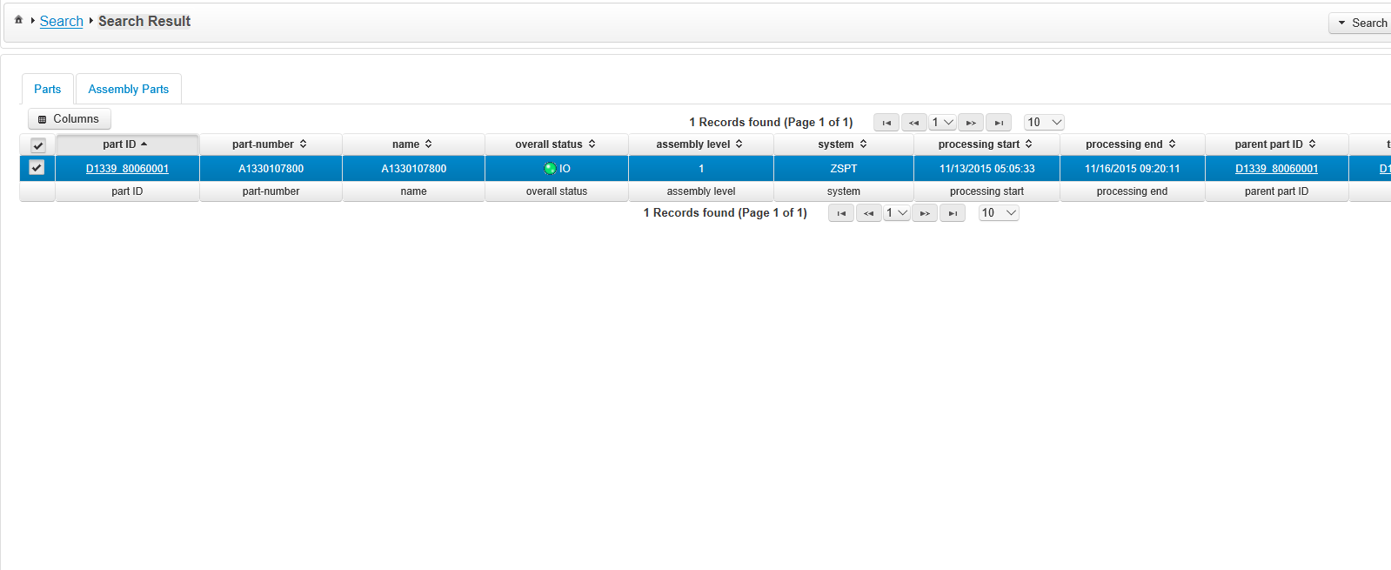
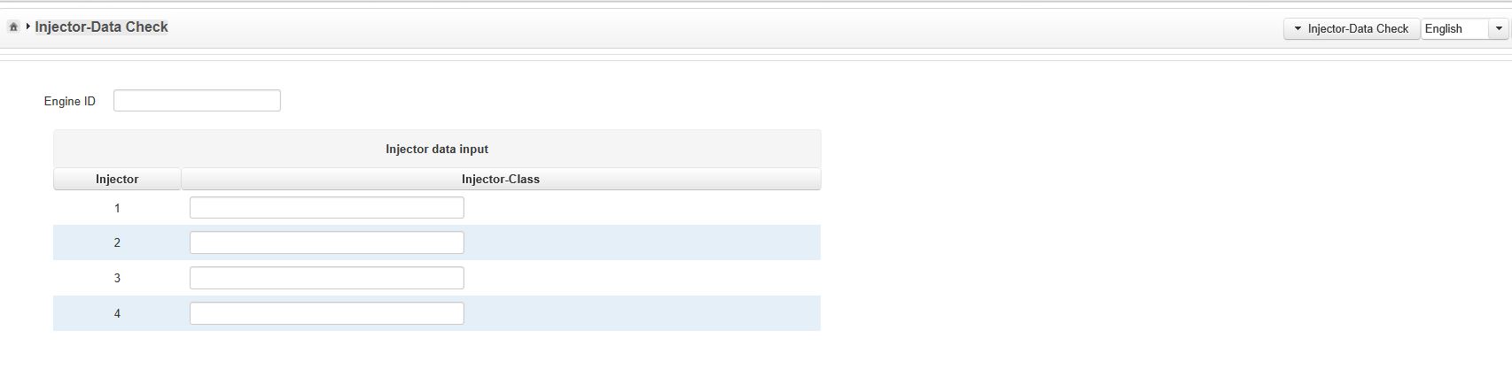
Search Result Page
In order to have Top-Level Engine ID as only input field ": injector Data Check. baseengine.present ->”TRUE"
On the Search result page click on the Part Id link
Module Switcher to navigate from Single recall to other modules.
PLA Recall user has option to change language from English to German and Vice Versa

Slide 11
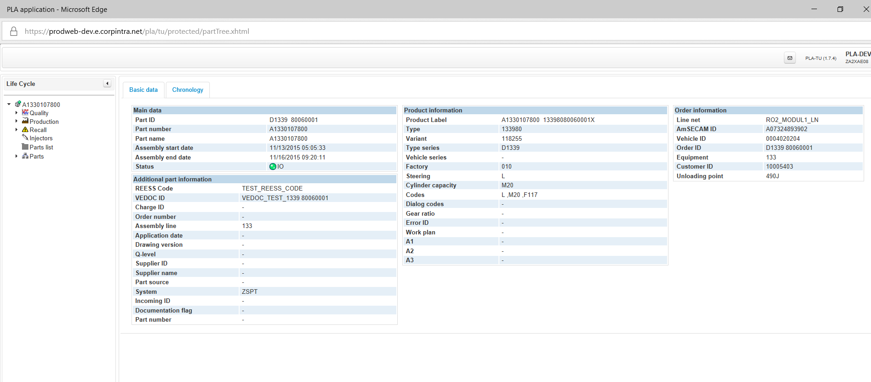
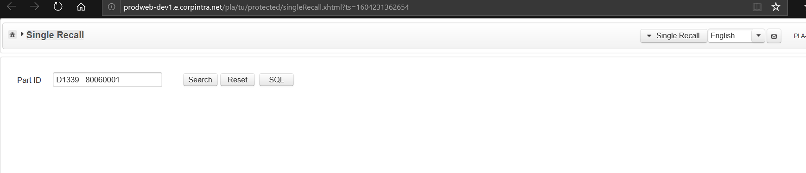
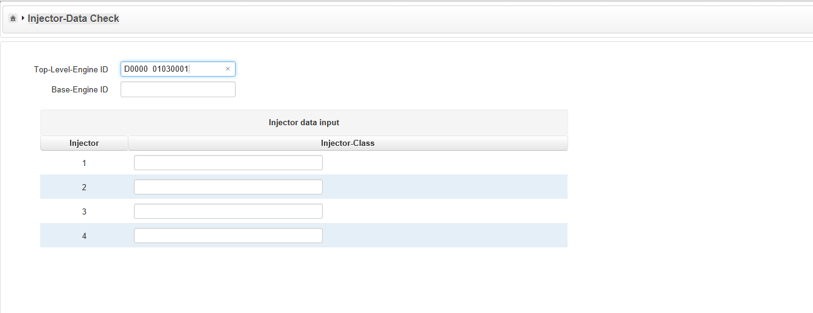
Life Cycle
The Basic data tab summarizes the data which is needed to provide a basic view of the currently displayed life cycle.
The chronology is a summary of all the work steps, recalls, transport messages and so on which have happened during the part's life cycle. The chronology is used to display all of these events in a chronological order. The chronology tab is always available and cannot be closed. Chronology data grid should get arranged by default based on timestamp(date column)
Input part ID”D1339 80060001” input field and Click on Search button. Search result is checked and displayed to PLA recall user by PLA system.
Main data Additional part information should be always visible And only visible if data is available-Product Information Order Information and Assembly Information

Slide 12
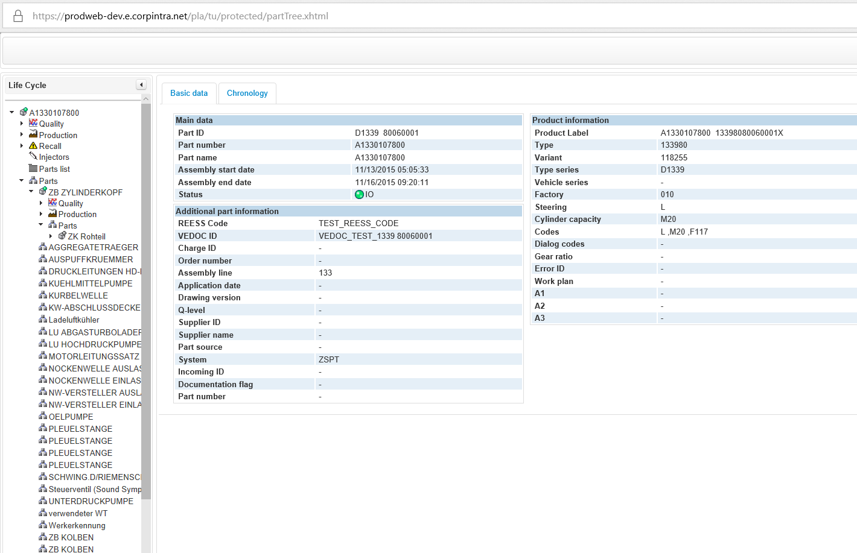
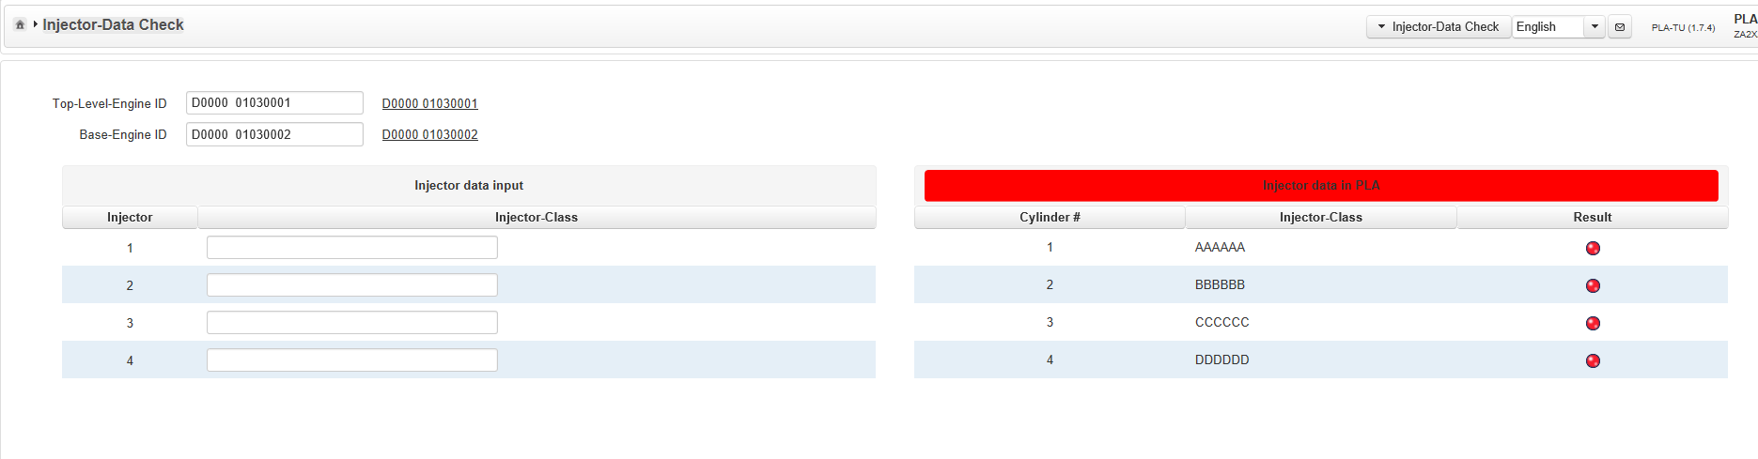
Life Cycle
This is the Root node for this Parts Life cycle.
Input top-level parent id"D0000 01030001" alone and click on Search button[Baselevel Engine ID- empty]
Result area should get displayed on RHS with injector values displayed and should be in RED color since no text matches
These are (Sub) Root nodes for attached parts
Input part ID”D1339 80060001” input field and Click on Search button. Search result is checked and displayed to PLA recall user by PLA system.
These are (Sub-Sub) Root nodes for attached parts

Slide 13
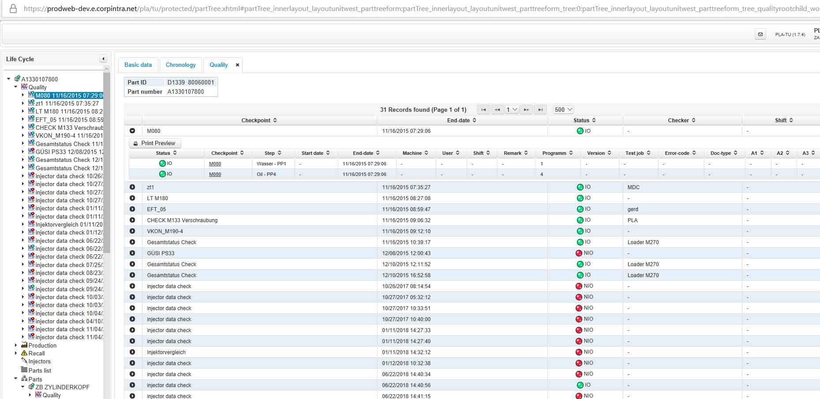
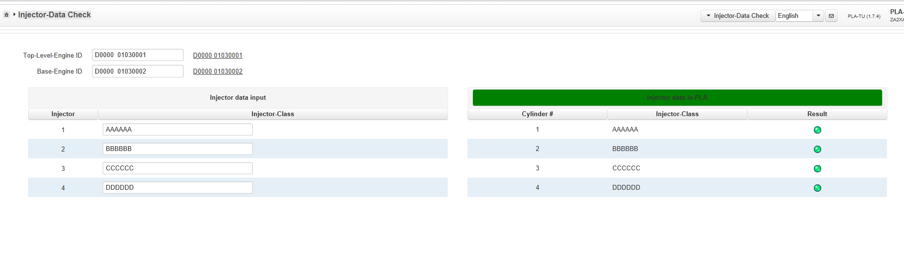
Life Cycle_Quality _
Expand the Quality nodes from Left hand side.
The small data grid on top of the quality tab shows general information (part ID and part number)
Hyperlink should appear corresponding to "Top-Level EngineID" and "BaseEngineId"
“Result" column in Result Area will show icon as green color. Green icon explains the matching the injector id. However result area table header will continue to be highlighted in red color(Overall Injector result are not matched with Injector Data Input)
Input top-level parent id"D0000 01030001" alone and click on Search button[Baselevel Engine ID- empty]
Base Engine id text field should get auto-filled with value.
selects any check-step from the accordion or any check-step node from the tree
BBBBBB
3 | CCCCCC
4
Input part ID”D1339 80060001” input field and Click on Search button. Search result is checked and displayed to PLA recall user by PLA system.

Slide 14
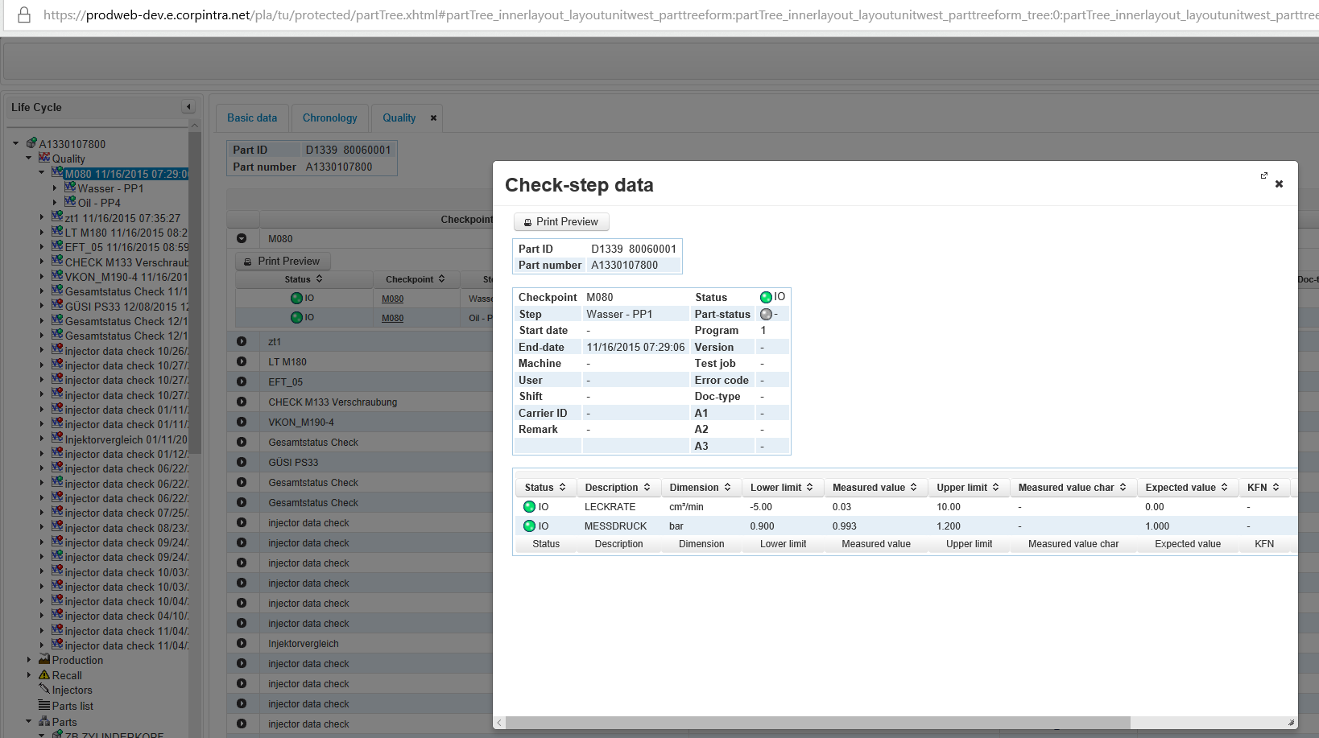
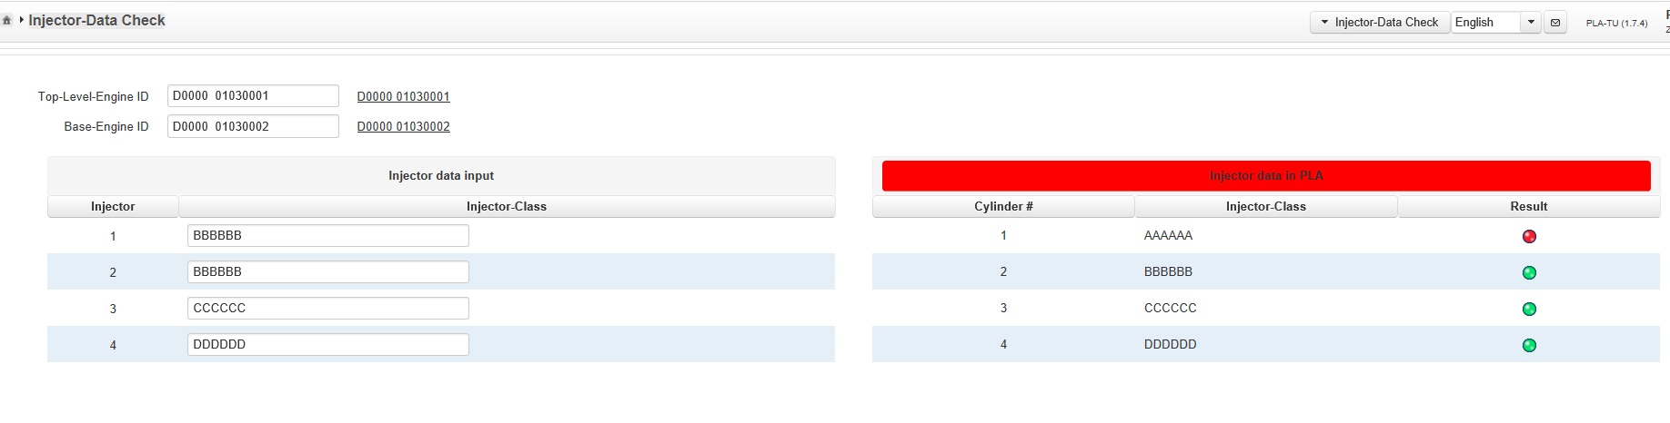
Life Cycle_Quality_Check-Step
PLA-System displays a modal pop-up window, showing detailed information about the currently selected check-step
Hyperlink should appear corresponding to "Top-Level EngineID" and "BaseEngineId"
Input top-level parent id"D0000 01030001" alone and click on Search button[Baselevel Engine ID- empty]
Base Engine id text field should get auto-filled with value.
BBBBBB
3 | CCCCCC
4
Input part ID”D1339 80060001” input field and Click on Search button. Search result is checked and displayed to PLA recall user by PLA system.
One Row of result area should contain status as “Red" icon and Rest other row should contain “Green " icon in result column

Slide 15
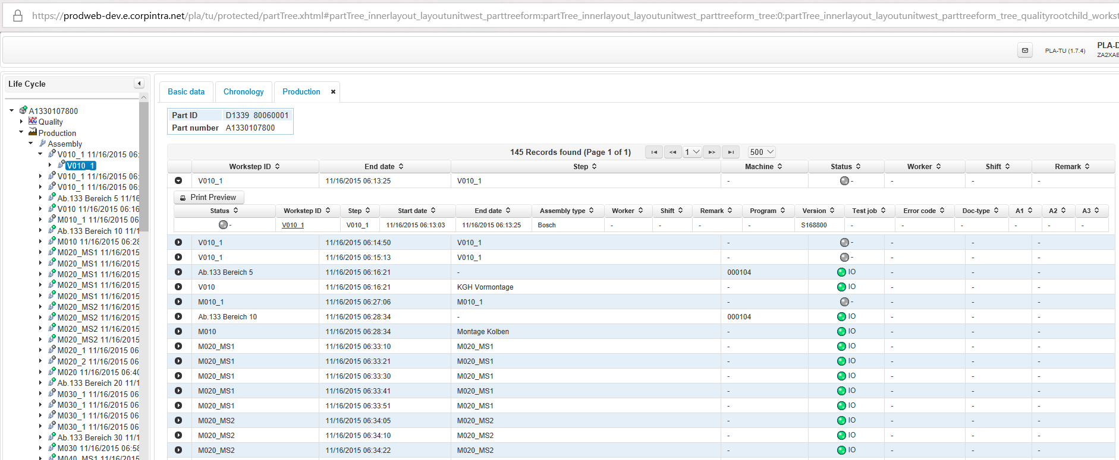
Life-Cycle_Production
The small data grid on top of the Production tab shows general information (part ID and part number)
Expand the Production nodes from Left hand side.
Hyperlink should appear corresponding to "Top-Level EngineID" and "BaseEngineId"
Input top-level parent id"D0000 01030001" alone and click on Search button[Baselevel Engine ID- empty]
Base Engine id text field should get auto-filled with value.
BBBBBB
3 | CCCCCC
4
selects any Work-Step from the accordion or any Work-Step node from the tree
Input part ID”D1339 80060001” input field and Click on Search button. Search result is checked and displayed to PLA recall user by PLA system.
Paste the Injector-Class _Result to Injector Data Input fields and click on search button.
Scroll bar is present

Slide 16
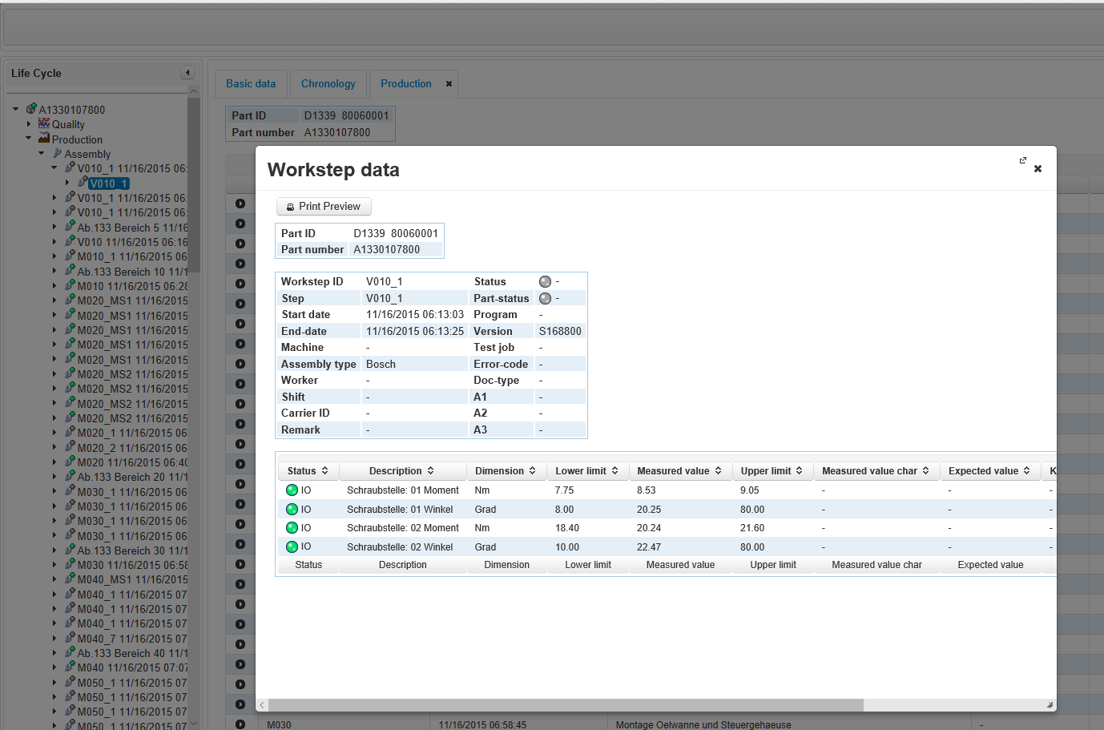
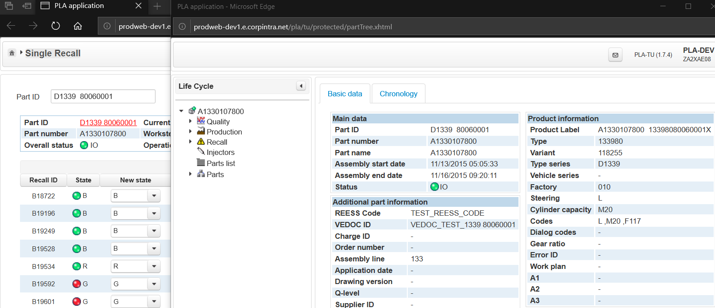
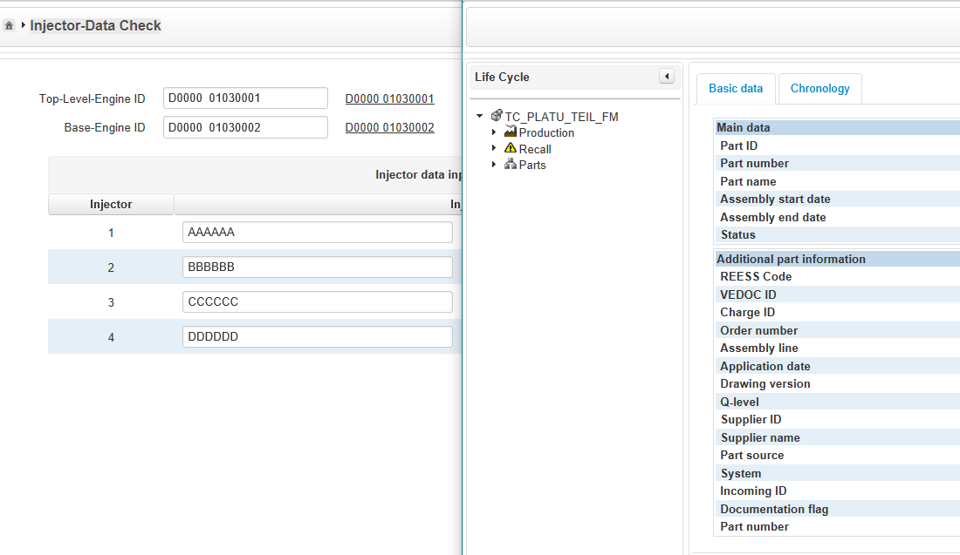
Life-Cycle_Production_Work-step
PLA-System displays a modal pop-up window, showing detailed information about the currently selected Work-Step data
.
Life Cycle window should be opened in Separate window. Complete Life cycle information of part can be seen here.

Slide 17
Life Cycle Lifecycle – logistics The logistics node is used to display all available logistics information related to the actual part. If no information is available, the node is not shown in the tree. If logistics information is available, every sub node of the shipments node represents one shipment. Lifecycle - recalls The recall view summarizes all the recalls, the part is assigned to. It's also used to display the historic recall data, so that every recall operation can be tracked by the PLA-User / PLA-Recall User.

